Slide 1

UNIVERSITY INSTITUTE OF ENGINEERING
COMPUTER SCIENCE ENGINEERING
Bachelor of Engineering (Computer Science & Engineering)
Subject Name: STATISTICAL METHODS USING R
Subject Code: 20SMT-460
Discrete Distribution
Mapped with CO
Prepared By:
Ms. Hardeep Kaur
DISCOVER . LEARN . EMPOWER

Slide 2
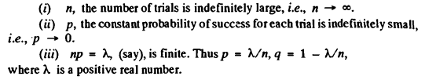
Introduction
Poisson Distribution (as a limiting case of Binomial Distribution). Poisson distribution was discovered by the French mathematician and physicist Simeon Denis Poisson (1781-1840) who published it in 1837.
Poisson distribution is a limiting case of the binomial distribution under the following conditions:

Slide 3
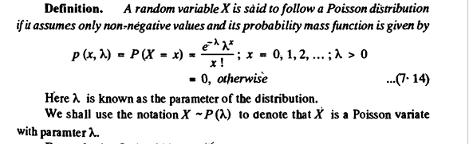
Poisson Distribution

Slide 4
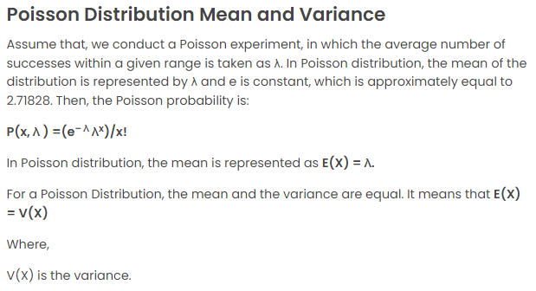

Slide 5
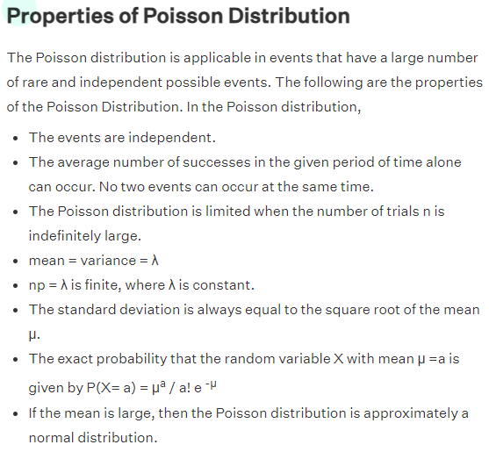

Slide 6
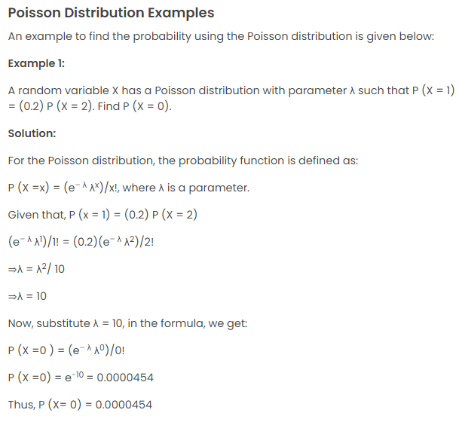

Slide 7
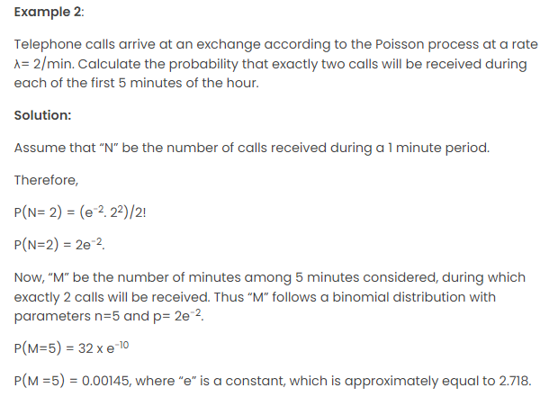

Slide 8
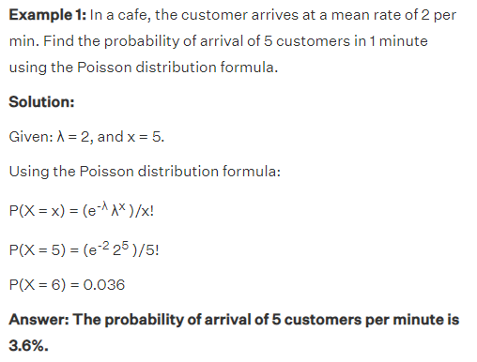

Slide 9
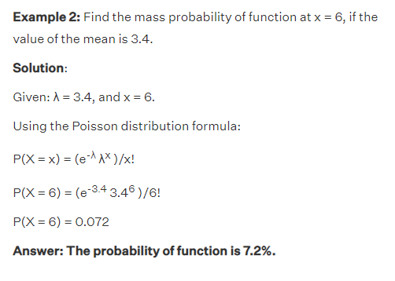

Slide 10
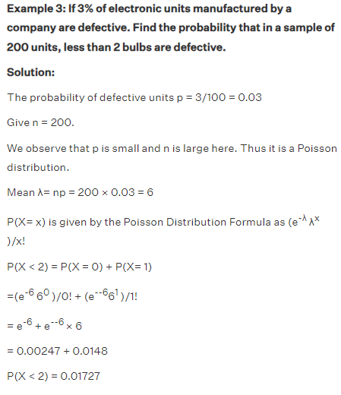

Slide 11
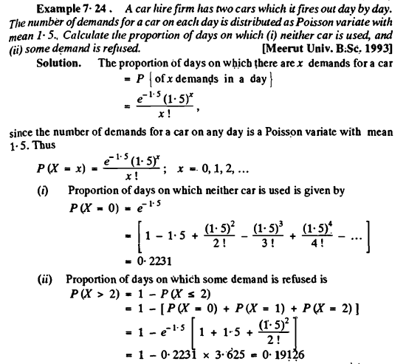
Examples

Slide 12
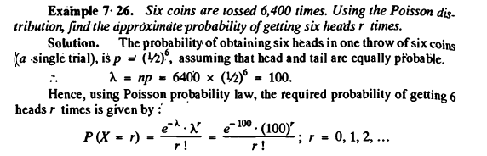

Slide 13
